Slide 1


Expense Management System
Prepared By:
Sarvagna Vemula
Ramlakhan Gupta
Nirmal Sugandhi
Aditya Singh
Sumit Shelke
Mentor: Suramya Biswas

Slide 2

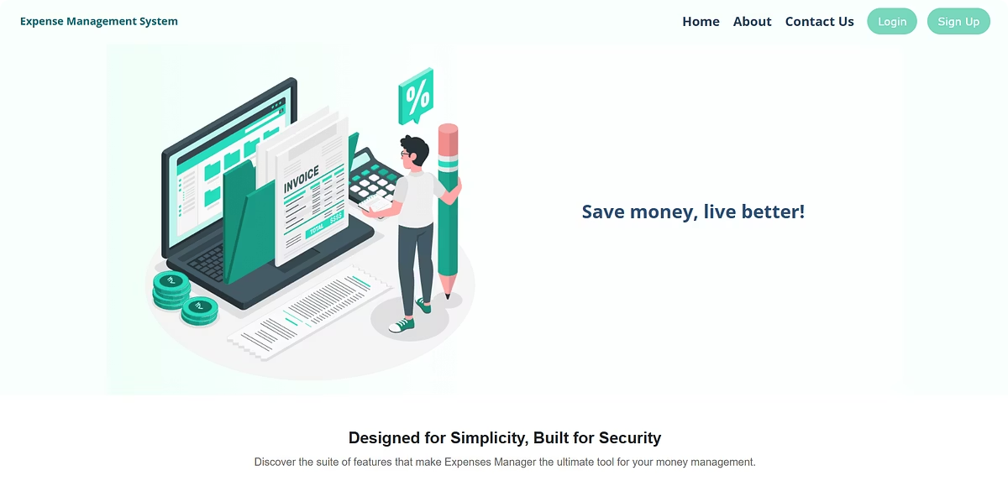
Expense Management System
A complete and intuitive Expense Management Solution designed for everyday users — whether it's a family member tracking monthly household spending, friends managing shared expenses, or individuals keeping an eye on their budget. Featuring essential modules, simple navigation, and a clean, user-friendly interface, it ensures effortless control over finances for all.

Slide 3


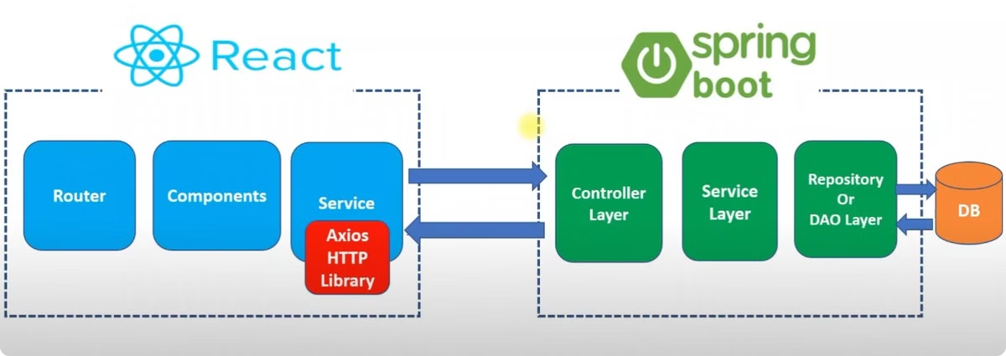


System Architecture
Customer Management
Manage customer profiles efficiently.
Category Management
Organize expenses into clear categories.
Expense Tracking
Monitor expenses with precision.

Slide 4

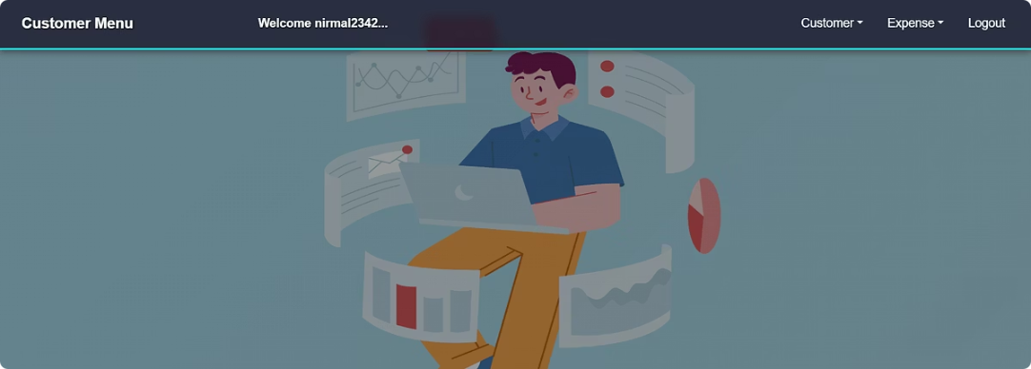






Customer Module Features
Expense Report
Customer Registration
Expense Entry
Generates report using pie charts and allows user to export them as PDFs.
New users sign up securely.
Add, edit and delete expenses.
Customer Details
Category List
Logout
Manage and update user information.
Organize expenses into categories.
Securely end user sessions.

Slide 5

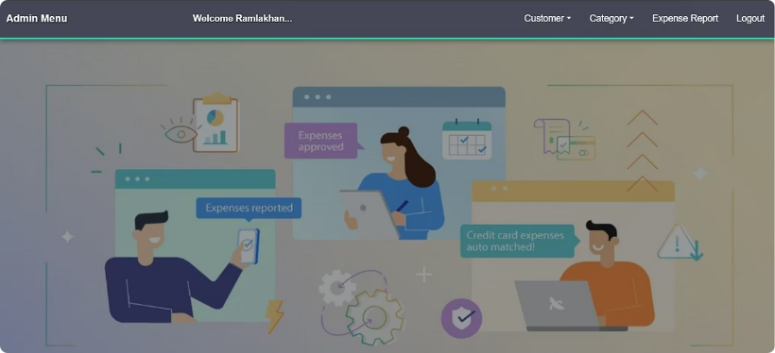
Admin Module
Expense Report
Customer List
Category List
Generates report for each customer using pie charts.
View and manage registered users.
View and manage expense categories.
1
2
3
4
5
6
Category Addition
Current Customer List
Logout
Add new expense categories.
Displays active customer status as True/False.
Securely log out from the system.

Slide 6

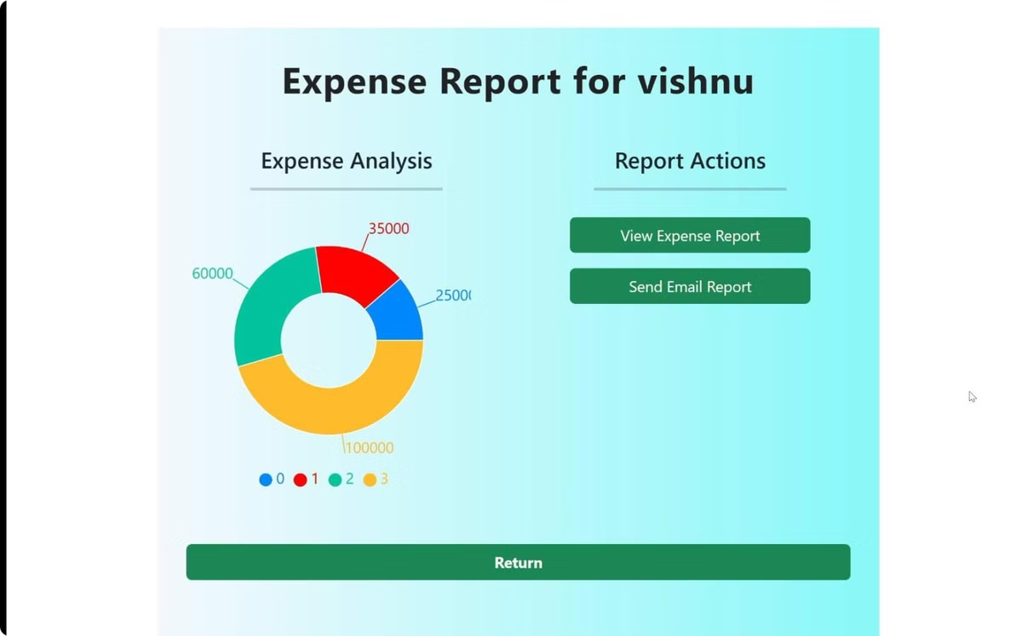
Expense Report
Admin and Customer both can generate visual expense reports using interactive pie charts for better financial insights. They can easily download these reports as PDFs and share them via email directly from the system.

Slide 7
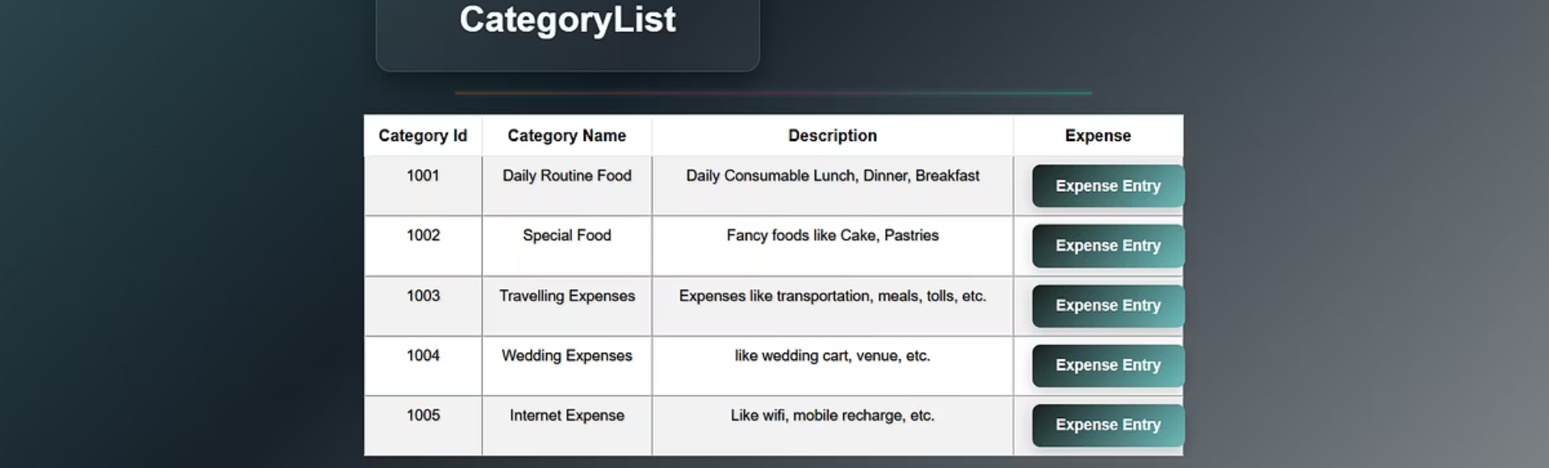
Expense Category Management
1
Custom Categories
2
Form Validation
3
Flexible Tagging
Define unique expense types.
Ensures accurate and secure data entry.
Organize expenses with tags.

Slide 8

Technical Implementation Details
ReactJS
Java
Version: 5.1.0
Version: 17
Dynamic user interface rendering.
Core backend programming language.
Spring Boot
MySQL
Version: 3.4.2
Version: 8.0.39
Framework for backend APIs.
Structured data storage system.
Eclipse IDE
VS Code
Version: 2024-12 (4.34.0)
Version: 1.99.1
Java development environment.
Streamlined UI development workspace.
Spring Data JPA
Version: 3.2.2
Efficient ORM for database operations.

Slide 9




Future Development Roadmap
Mobile App
Cross-platform support
Multi-Currency Support
Allows transactions and reports in different currencies
Vertical Scaling
Increasing the capacity

Slide 10
Conclusion
The Expense Management System is a secure, efficient, and scalable solution that simplifies expense tracking, categorization, and reporting. Built using Java, Spring Boot, and MySQL, it reduces manual work, improves financial transparency, and ensures compliance.
With the potential of Artificial Intelligence and Cloud-Native deployment, the system is future-ready—aiming to become a comprehensive, intelligent financial management tool for both individuals and organizations.

Slide 11

Thank You!

